Slide 1
Business/Tech Park In Bengaluru City
By: Krishna Ramadas

Slide 2
Problem
Bengaluru aka Bangalore is one of the fast-growing metro cities in INDIA.
It is also known as the "Silicon Valley" of India
Business/Tech parks are changing the outlook of the city
Find an apt location for the construction of a business/tech park

Slide 3
Data:
List of neighborhoods in Bengaluru city from Wikipedia
Latitude and Longitude data from geocoder
Venue data in Bengaluru city from FourSquareAPI
The latest property (land) rate in Bengaluru from property guidance sites

Slide 4
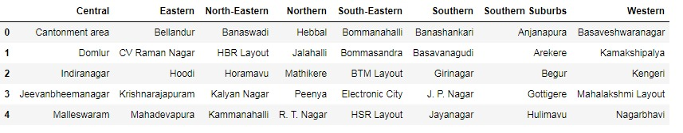
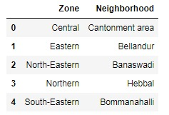
Data scraping and wrangling
Data is scraped using read_html method from Wikipedia page
8 administrative zone and associated neighbourhoods were tabulated
The data frame is transposed and columns were named as "Zone" and "Neighborhood“

Slide 5
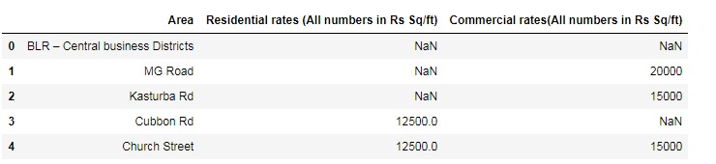
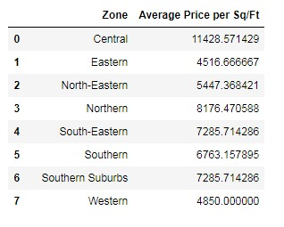
The data required for knowing the average price of the property (land} scraped from land guidance website using read_html method
All the neighbourhoods, zone names were under one column "Area", this had to be sliced according to each zone and renamed
Data cleaned and moulded according to neighbourhood dataset.

Slide 6
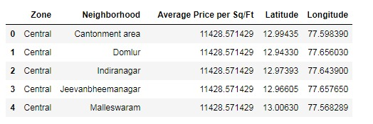
Geo-coordinates (latitude and longitude) of the neighbourhoods obtained using Python geocoder package
Final working Data set:

Slide 7
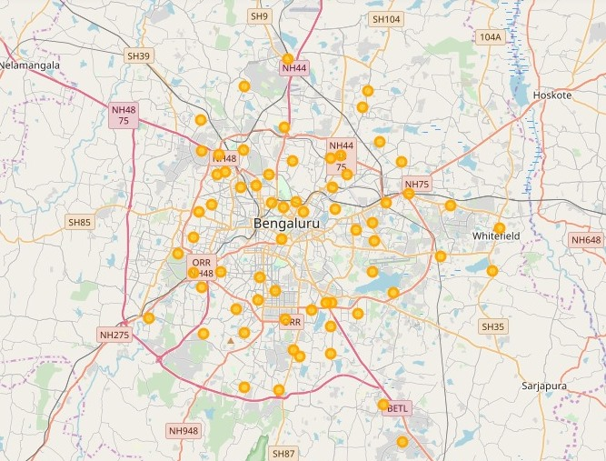
Data Visualization
Bengaluru city Map with the neighborhoods superimposed on top
Created using folium library from python.

Slide 8
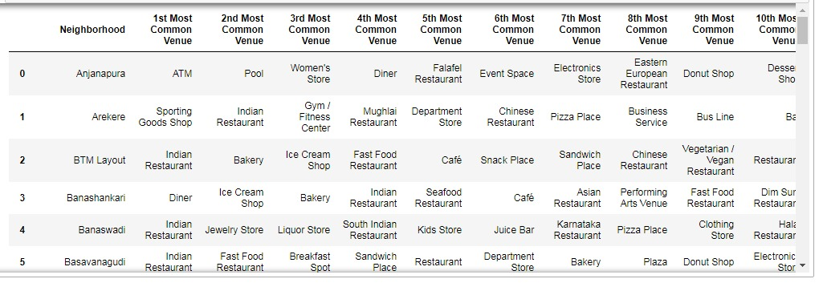
The Foursquare API is used to extract venue data of each neighborhood
Each neighbourhood is analysed and the top 10 venues are found

Slide 9
K-Means Clustering
K-Means is used to cluster the neighbourhoods
The value of k, is found using the silhouette method
New data frame is formed with the cluster labels, along with the venue data of each neighbourhood
The average prices of the land is binned into 5 different levels and a new column “Price Categories” is added to the dataset.

Slide 10
Results and Discussion
There are 65 neighbourhoods as listed in the Wikipedia page
The city is divided into 8 administrative zones.
There is no borough system in the city division here in Bengaluru

Slide 11
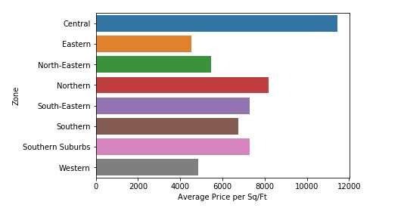
The central zone is quite expensive almost Rs.12000 per sq/Ft
Eastern, Western zones have the lowest land price almost Rs 5000 per sq/Ft

Slide 12
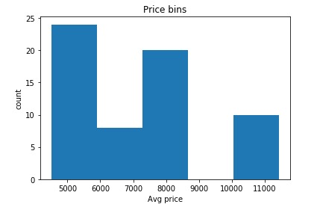
The average price is binned into 5 categories.
Categories:
Low level
below average
Average level
above average
high level.

Slide 13
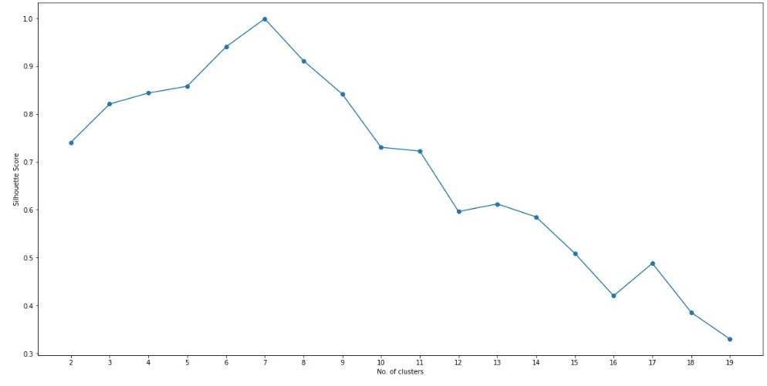
The silhouette method showed k=7 for the K-Means clustering algorithm

Slide 14
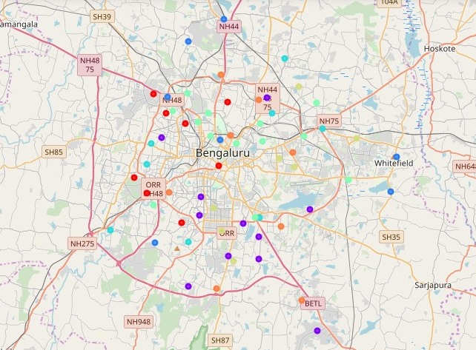
The neighborhoods are divided into 7 clusters:

Slide 15
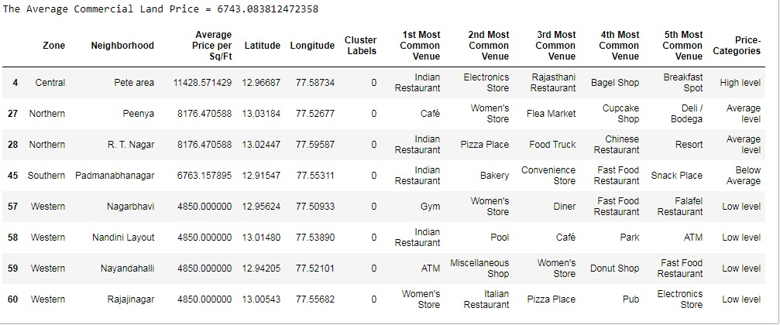
Cluster 1

Slide 16
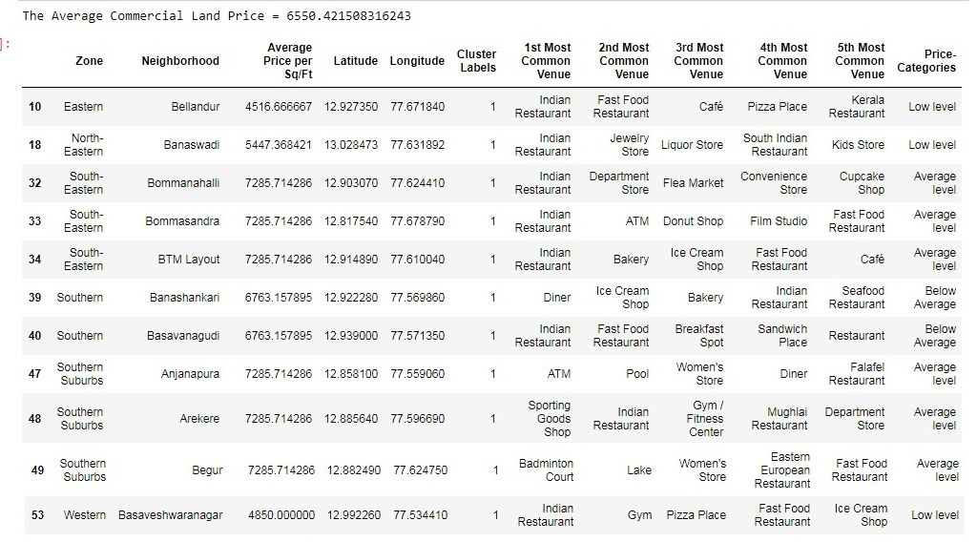
Cluster 2

Slide 17
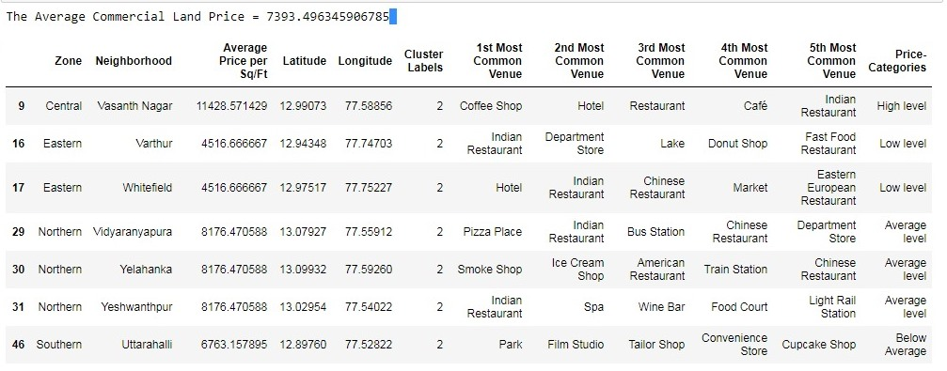
Cluster 3

Slide 18
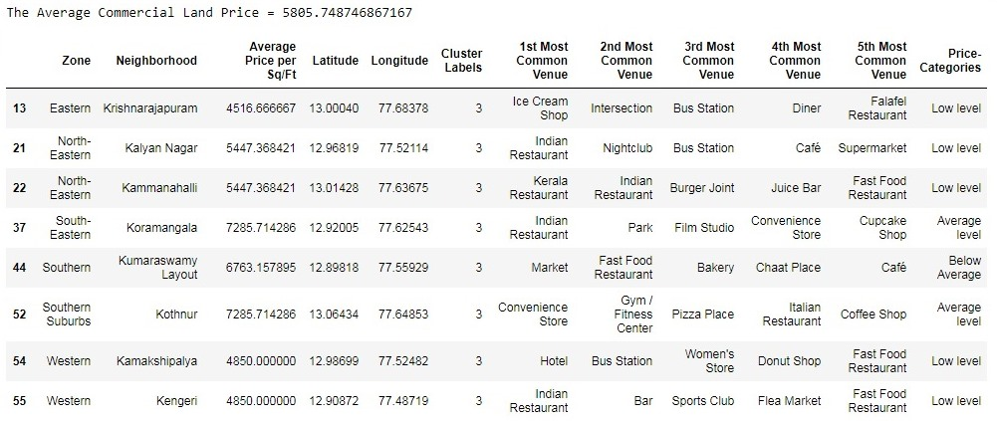
Cluster 4

Slide 19
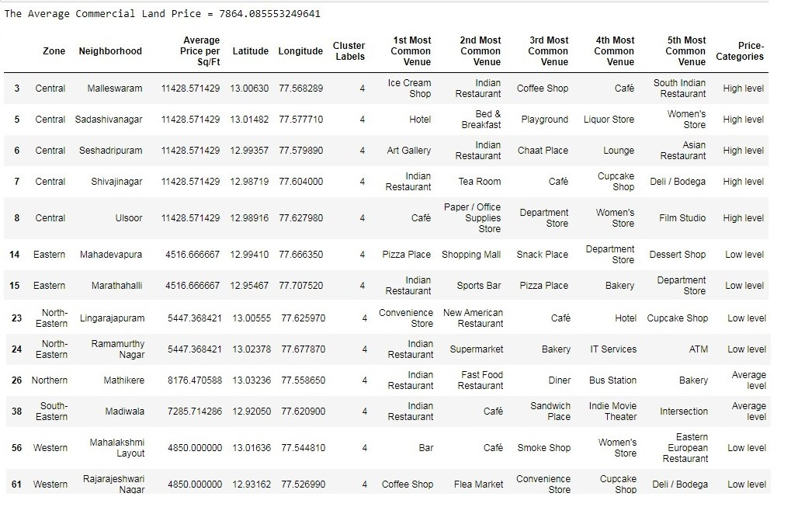
Cluster 5

Slide 20
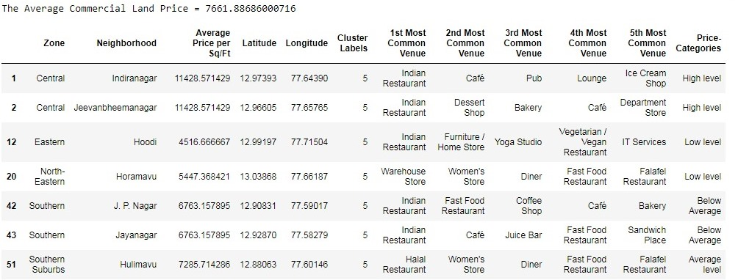
Cluster 6

Slide 21
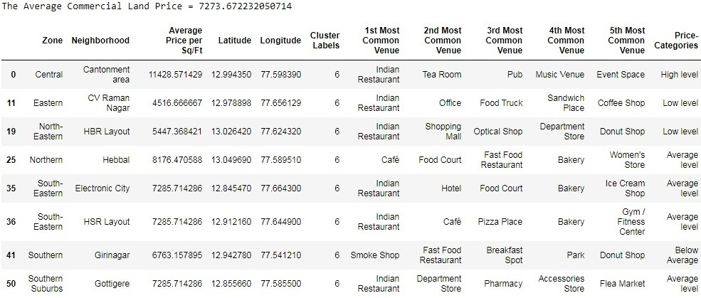
Cluster 7

Slide 22
Conclusion
The ample location is preferably in cluster 5, but the land price is the highest for this cluster.
Cluster 3. Since we can't reject this location based on not having a public transport. Maybe there will be one top 10. The price of land is also on the fair side here.
Following up with the above point, clusters 4, 6 and 7 also comes in the prospective location list. They all lack one amenity or the other. But the price is also on a fair side.
The preference list for the location can be listed as follows:
Cluster 5
Cluster 3
Cluster 7
Cluster 4
Cluster 6

Slide 23
Analysis is performed on limited data.
May be right or maybe wrong.
If a good amount of data is available there is scope to come up with better results.

Slide 24
Thank You

